Slide 1
Minimizing Costs of Municipal Water Distribution Leak Repair
Utah State University, CEE5410
December 04, 2025
Ty Gilbert
ty.gilbert@usu.edu

Slide 2

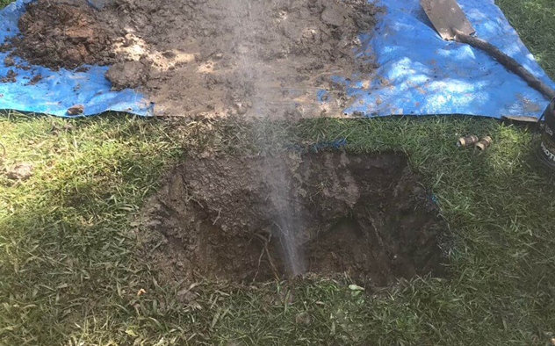

The Challenge
•
Aging Infrastructure: High failure rates in legacy systems.
•
Water Scarcity: Non-Revenue Water loss is unsustainable.
•
Budget Gaps: Cannot afford to inspect 100% of pipes.
•
Reactive Trap: Inefficient "fix-it-when-it-breaks" mindset.

Slide 3






The Approach
Optimization (MILP)
Acoustic Inspection
Capacity Rule
Binary decision logic (0/1) for every pipe: To Inspect or Not? To Repair or Not?
Deploying acoustic sensors to proactively detect hidden leaks before catastrophic failure.
Critical Constraint: Leaks steal pipe capacity. Repairs are forced to ensure delivery.

Slide 4


Project Findings
Smart Budget Allocation Funds are automatically directed to high-consequence leaks.
Guaranteed Reliability The capacity constraint successfully prevents "zero-repair" cost-cutting solutions.
Proactive Strategy Targeted acoustic detection is significantly cheaper than passive water loss.

Slide 5

References
Nagapurkar, P., Sharma, N., Garcia, S., and Nimbalkar, S. (2025). Evaluating Acoustic vs. AI-Based Satellite Leak Detection in Aging US Water Infrastructure: A Cost and Energy Savings Analysis. Smart Cities, 8(4), 122. https://doi.org/10.3390/smartcities8040122
Source: dcmplumbing.com.au
  https://dcmplumbing.com.au/wp-content/uploads/2022/07/burst-pipe-underground-2.jpeg

